Slide 1
Grassroots Soccer
All football which is
non-professional and non-elite
is defined as grassroots
(All children’s football is grassroots)
Compiled by Terry Michler
UEFA Grassroots Program
www.cbcdutchtouch.com

Slide 3
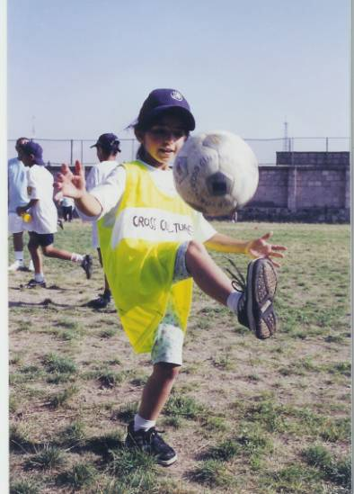
UEFA Grassroots
Picture of the Year

Slide 4
What is Grassroots Soccer
It is a question that must be answered with clarity and passion.
There must be a common understanding about its purpose, categories, values, importance and its relationship with the top level.
Soccer has 3 levels:
the professional game (stars)
the top-class youth level (rising stars)
the non-elite grassroots level

Slide 5
What is Grassroots Soccer - 2
For some it is:
Recreational fun activities -- casual, friendly
School or club-based soccer --
regular training and organized match schedule
Structured development program --
for a limited number who show outstanding potential

Slide 6
What is Grassroots Soccer - 3
Grassroots soccer comes in a variety of packages and categories –
Amateur clubs
Schools, companies, other organizations
Futsal
Beach soccer

Slide 7
What is Grassroots Soccer - 4
it’s much more than just winning and losing
Encourages social integration
Creates a sense of community
Supports health education
Provides help for disadvantaged groups

Slide 8
What is Grassroots Soccer - 5
Benefits to the game in general
Source of future fans, referees, administrators, soccer moms, officials, and sponsors….. not to mention players
Encourage mass participation to keep people in the game as long as possible

Slide 9
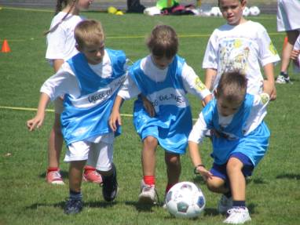
Grassroots Soccer

Slide 10
Football is not a sport for the elite……
It is available for everyone, irrespective of size, shape, color or faith.
It is a real sporting democracy, which offers educational values, health benefits, social opportunities, and sporting worth. The game is a wonderful vehicle for personal and sporting development.
At the base of the football pyramid, grassroots football benefits all levels of the game.
UEFA's mission as the parent body of European football includes helping to ensure that the sport maintains a healthy grassroots –
the foundation on which the élite game can thrive.

Slide 11
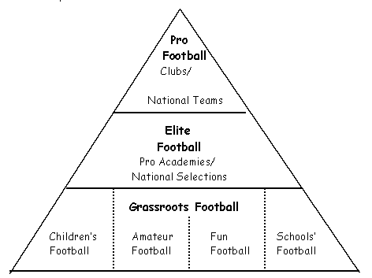
Football is not a sport for the elite……

Slide 12
The UEFA Grassroots Football
‹ Football in Amateur Clubs
‹ Street Football
‹ Schools Football
‹ Holiday Football
‹ Beach Football
‹ Leisure Football
‹ Football in Cities and Suburbs
‹ Football in rural areas
‹ Indoor Football, Futsal
‹ Football for disabled
‹ Veteran Football
‹ Company

Slide 13
Grassroots philosophy / infrastructure
Football for all, everyone has a chance to play,
#1 international sport in the world
No discrimination - fair play, anti-racism, anti-sexism,
Players come first - good practice, child protection, safety, relationships, teamwork
Take the game to the underserved, where they live
Action must be dynamic, simple, exciting and rewarding

Slide 14
Grassroots football is:
‹ Safe
‹ Open
‹ Everywhere
‹ Lively
‹ Fair
‹ Simple
‹ Creative
‹ Personal
‹ Enjoyable

Slide 15
The UEFA Grassroots Educational Aims:
1. Respect
2. Health
3. Skill
4. Integration
5. Enjoyment

Slide 16
UEFA’s Role in Grassroots Development
1. To stimulate interest in the grassroots of the game through promotional activities and materials
2. To support grassroots programs by providing expert assistance and equipment and facilities
3. To assist with the continuous education of national associations by organizing courses and conferences
4. To produce grassroots guidelines and advice to all relevant agencies
5. To recognize and recommend best practice in the field of grassroots football
6. To generate new ideas in grassroots development and to organize pilot schemes.
7. To monitor grassroots developments throughout Europe

Slide 17
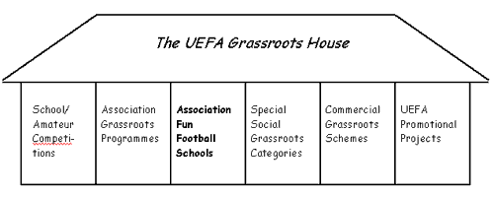

Slide 18
UEFA Grassroots Charter
Leaders Programs
Certified Courses
(min. 60 hours)
Volunteer Courses
(min. 12 hours)
Players Programs
for children (5 12)
for youth (12 19)

Slide 20
Growth of Grassroots Soccer
Year Players
500,000
1,300,000
2,200,000
2,500,000
4,600,000
33 of UEFA 53 national associations are now members,
in just 4 years time

Slide 21
EUFA’s 7 Star Rating Scale
To achieve 1 star: basic grassroots structure, grassroots philosophy, organizing the required number of training programs for players and coaches.
4 additional stars can be acquired, with 1 star per each of the following:
The number of players participating in the program
The number of girls and women who play
The number of social programs
The number of promotional activities and events
These can be collected in any order
To get a 6th star, you must have achieved the previous 5 stars, plus:
have proof of special investments in the grassroots , high-level training programs for players and coaches, a well-developed infrastructure, ‘education through football’ schemes, and imaginative promotional activities
A 7th star for those who have achieved the previous 6 stars, plus: advanced, comprehensive program, both in terms of quality and quantity

Slide 22
Start your own Grassroots Soccer Program!
For Soccer's Sake!
Constant development of the game is imperative
The foundation of all football growth and advancement lies in the grassroots.
Grassroots football needs qualified leaders, at the political, administrative and technical levels.
Volunteers at every level of the organization

Slide 23
Start Your Own Program - 2
We believe those most passionate about soccer have a duty to spread the world’s game to more people. There are two primary reasons underlying this belief.
The most important reason is the benefits a high level activity provides to the youth involved. Study after study show youth with involvement in a high level activity have better grades, better health, higher self esteem and are less likely to engage in the taking of drugs and alcohol.
The second reason passionate soccer people have a duty to spread soccer is their own Club’s progress and health. If you are a board member, coach, manager or a parent you have a duty to help your Club make progress towards a brighter future for more players. A great way to help your Club make this progress and remain healthy is to invest in your base.

Slide 24
Start Your Own Program - 3
Football associations that are serious about the game's health and growth are duty-bound to promote mass participation and interest…
Grassroots football, which acts as a vehicle for social integration, health and happiness, is the aim.
As a by-product, talents will emerge

Slide 25
Designing a Grassroots Program
Political support
Grassroots philosophy and plan
Grassroots administrator
Grassroots leaders/ coaches
Adequate grassroots facilities and equipment
Grassroots structure
Training material, promotional ideas
Former players as grassroots ambassadors
Grassroots targets

Slide 26
3 Needs to Satisfy
Political / public support of grassroots program
An organization / structure to implement the schemes
The technical know-how in the form of enlightened parents and trained coaches

Slide 27
Growing Grassroots Soccer
There is no precise recipe for success across a landscape so varied, with constantly changing and growing conditions.
Combining knowledge from a variety of sources, a great deal of careful observation with practical knowledge will help.
At grassroots level, there is no obvious reasons for conflicts to arise. Good working relationships need to be built between clubs, based on respect for each other’s objectives.
Grassroots must keep the base of the pyramid as wide as possible and to address the issue of dropouts in the 13-15 age group and maintain the objective of providing soccer to everyone who wants it.

Slide 28
Grassroots Structure and Support
Establish the following:
A grassroots committee
A dedicated grassroots manager
A grassroots strategy
A grassroots budget
Incorporate commercial sponsors and public funding
Former players, politicians, celebrities
Festivals, school projects, soccer schools, tournaments

Slide 29
Social Benefits
Modern day children and teenagers have experienced a rapid change in the conditions of growing up – a process that has become more accelerated than ever before.
The change offers new opportunities, but also new burdens and threats which their parents were not exposed to –
New pressures in many forms, accompanied by fear of failure.
Many players drop out of soccer today because they were subs on their teams and not given enough opportunities to play.
The percentage of children and teenagers with social problems, emotional disturbances and physical impediments continues to grow.

Slide 30
Social Benefits - 2
Mastering the typical adolescent crises and constructing an identity are core issues.
The team structure of a soccer club is important for personality and identity development. Research indicates that young people in a sports organization can be distinguished in a positive way from those who have left the organization or never been a member.
Participation in sports contributes to the young person bearing lighter loads of physical, psychological and social stress than their non-sporting classmates. Participation in sports also offers opportunities for positive expression and the possibility to dismantle certain negative stresses. Also allows for social integration.

Slide 31
‘Catchy Titles’
McDonald’s Football Celebration
Football Without Limits
Cup of Hope
Fun Football
All Stars Football Carnival
Let’s Bring Joy to the Children
Together We Are a Team
Have Faith in Yourself
Girls Only Road-show
Young Champions
Starball

Slide 32
Approaching Sponsors
Forge links with the following:
Agencies dealing with sport, education, health, welfare, crime, drugs, homeless, anti-social behavior, rehabilitation programs, and refugees --
all of whom stand to gain from grassroots soccer projects.
Provide compelling data of how grassroots schemes contribute to different government priorities and objectives.
Maximize dialogue, develop detailed action plans involving key partners, train staff members to deal with ‘political relationships’,
Use major international events or tournaments to raise the profile of grassroots soccer

Slide 33
Big Time + Small Time = Great Time
UEFA sponsors a 24-hour 5 a side match at the sight of the Champions League Final contested in shifts of around 1,000 players representing the two teams in the Final. Boys and girls of all ages participate and get to meet the star players from the real teams of the Final.
In Istanbul in 2005, 850 goals were scored and the final score of the match was 427 to 423. The last Final in Moscow saw Red Square turn into a Footballing Festival with a 5 a side pitch made to look like the real match pitch.

Slide 34
Yesterday’s Child
Played soccer in the streets -- street motivation was intrinsic, with a love of the game and a fascination with the ball, the main reasons to play. If soccer was in your blood before the age of 12, it was there for life.
Yesterday’s child learned to be self-sufficient, today’s child learns to be passive.
Free play must be part of the developmental process if spontaneity, independence and free expression are to be nurtured.
Yesterday’s child learned by trial and error, by experimenting, by constant practice.

Slide 35
Yesterday’s Child - 2
Yesterday’s child loved tricks and clever moves, they were hungry for imaginative moves and adventurous play. Today coaches need to create small-sided games that encourage children to find solutions to the game’s problems.
Yesterday’s child lived in a different world – an imperfect world of modest means and poor infrastructure, where soccer became entertainment and social interaction and creative expression. Today’s child is bombarded by electronic and sporting options.
Today’s players need to learn more about self-reliance, commitment, and free expression from the passionate young dreamers who played under the streetlights in the past.

Slide 37
What is Grassroots Success ?
One of the primary objectives is to avoid subjecting youngsters to ‘performance pressure’ and to allow them to enjoy a game of soccer on their terms/
Up until the age of 11 or 12 – ‘success’ can be measured by the level of participation, the fun and friendships created in the soccer environment.
Beyond that there are various yardsticks to measure ‘success’. The basic idea is that every individual should have optimal chances to satisfy their needs and ambitions and perform effectively within the team framework.

Slide 38
What is Grassroots Success ? -2
‘Success’ in grassroots soccer is very relative to the ability and ambition of the individual player. For some it is to move to a higher level to progress and further develop their game. For others it is continued enjoyment from playing with their friends on a more limited basis
Success should be considered as giving everyone the opportunities to play and to take part in social activities built upon the foundation of team spirit.
Grassroots success is about pinpointing the needs and investing time and effort in catering to those needs in a way that will allow as many people as possible to continue in the game for as long as they want.

Slide 39
Quality or Quantity ? Both !!
Starting with the premise that grassroots soccer is primarily a social activity and that many sectors of the community can become involved, you can combine quantity with quality.
Setting targets create dynamics -- growth, outcomes, healthy alternatives, solid educational platform for basic social and human values like tolerance and respect.
Sponsors may more likely invest if they see the community involved and positive benefits being realized.

Slide 40
3 ??? About Soccer Philosophy
1. What do we believe in ?
The power of soccer to make a difference in people’s lives
2. What do we value ?
Value the game for its simplicity, passion, and creativity
3. What do we see ahead ?
Soccer’s popularity increasing and its social impact expanding

Slide 41
Purpose of Grassroots Soccer
Encourage participation
Promote a love of the game
Introduce the skills and basic concepts to a new generation of players
The grassroots environment is therefore a place for everyone who wants to play, where integration and social skills are fundamental.
Producing star players is a by-product of grassroots -- elite player development is the responsibility of the club on more of a day to day basis
The roots of the game must not wither, they must be continually watered

Slide 43
Levels of Play and Involvement
Fundamental
Intermediate
Advanced (elite)
Grassroots ……. Experience
Recreational ….. Fun
Competitive …… Ambition
Elite …………….. Talent, Performance

Slide 44


